Slide 1
The Wave Nature of Light

Slide 2
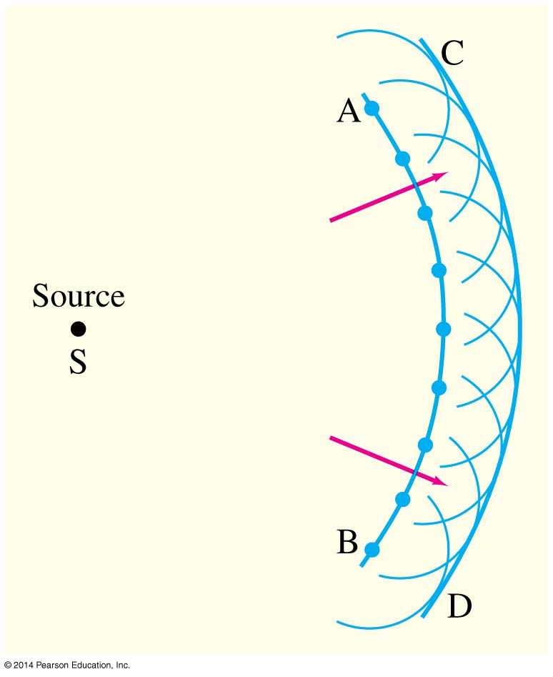
Huygens’ Principle
Huygens’ principle: Every point on a wave front acts as a point source; the wavefront as it develops is tangent to their envelope

Slide 3
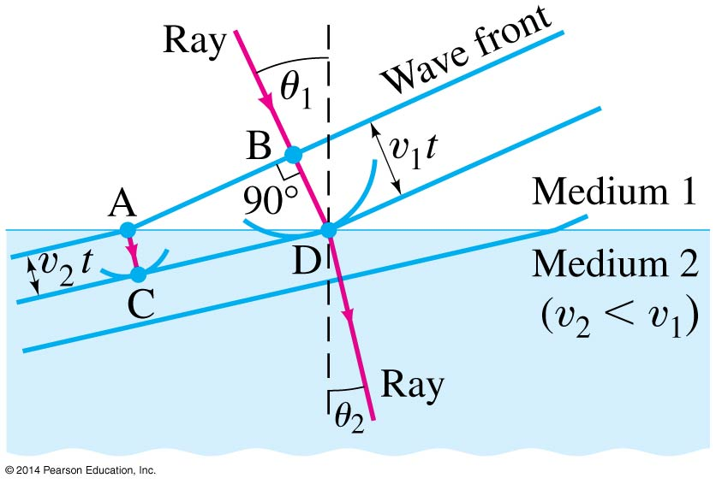
Huygens’ Principle and the Law of Refraction

Slide 4
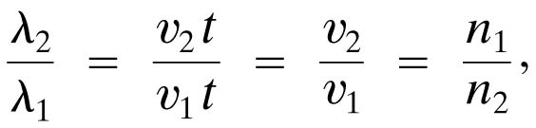
Huygens’ Principle and the Law of Refraction
Huygens’ principle can also explain the law of refraction.
As the wavelets propagate from each point, they propagate more slowly in the medium of higher index of refraction.
This leads to a bend in the wavefront and therefore in the ray.
The frequency of the light does not change, but the wavelength does as it travels into a new medium.

